Slide 1

Singapore Construction Market
Protik Mazumdar

Slide 2








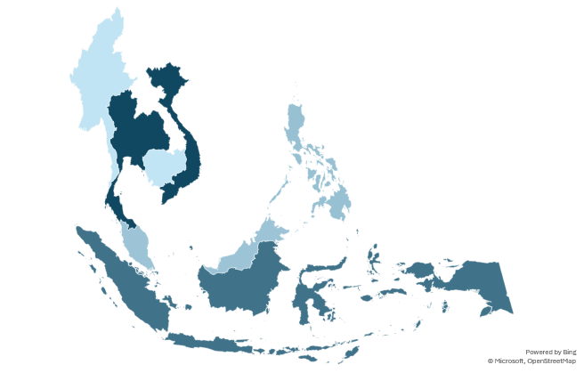
Singapore’s projected GDP growth for 2025 stands at 2%, placing it as the second-lowest among Southeast Asian economies
Growth rate of Gross Domestic Product (GDP) Projection ¹, 2025, USD Trillion
GDP growth (%) 2025
Map of Southeast Asia
Source: (1) International Monetary Fund, Real GDP Growth, website as accessed in July 2025; (2) McKinsey Southeast Asia (3) Map created by internal team.

Slide 3




Despite global trade tensions and sectoral headwinds, Singapore’s growth is driven by resilient construction and a digitally driven infocomm sector
Headwinds from global trade tensions
Sluggish growth sectors
Growth sectors
Construction sector remains resilient, with a solid pipeline and productivity gains through robotics, digitalization, and green technologies.
Manufacturing and tech sectors face headwinds from soft global demand and a moderating chip cycle, though AI-driven demand continues to support high-performance semiconductor growth.
Prospects for global GDP growth have diminished amid the trade conflict.
Trade conflicts have significantly impacted the economy, with externally oriented sectors like manufacturing expected to face subdued demand.
Growth is expected to slow to 0.0–2.0% in FY‘25 from 4.4% YoY, resulting in output gap turning negative.
Financial services face volatility-induced slowdowns in trading and investment activity
The information & communications sector is set to grow steadily, driven by digital transformation and Budget 2025 support for data and cloud infrastructure.
Consumer-facing sectors face challenges from high labour costs and weak demand, though mild growth in F&B firm formation signals adaptability and innovation.

Slide 4
Singapore’s economic fundamentals remain strong despite global volatility
Growing Economy
Singapore’s economy sees surprise expansion in Q2 despite US tariff uncertainty
Household net assets is expected to nearly double to $4 trillion by 2030, driven by
Equity market reform
Policies that expand the nation’s hub status
Productivity increases from the early adoption of new technologies.
Singapore's Real GDP Growth¹ (%)
Quarterly
Annual
Growing construction sector
Construction sector grew 4.9% YoY in Q2 2025
Growth supported by
Falling interest rates, which lowered borrowing costs
Stronger property market activity
Continued momentum from public infrastructure investments
GDP from goods-producing industries YoY (%)

Slide 5
Singapore dominates in Foreign direct Investment, attracting 3x more FDI than the second-ranked Southeast Asian country
Southeast Asia FDI 2024 ($ Bn)
$192
In 2024 Singapore attracted $192 billion in FDI
The top five source economies for Singapore’s FDI inflows were the United States of America (USA), the United Kingdom, Japan, Mainland China and Ireland. Collectively, they accounted for 54.0% of total FDI inflows in 2024.
Singapore remains a top destination for investors, projections indicate FDI could surpass $ 200 billion by 2028
Singapore FDI country wise 2024 ($ Bn)

Slide 6
Over the past five years, Singapore has consistently ranked among the top positions in economic performance
Competitiveness in Singapore as compared to other Asian countries
Economic performance rankings
Singapore
Thailand
Japan
India
Philippines
Business efficiency rankings
Singapore
Thailand
Japan
India
Philippines
Source: International Institute for Management Development (IMD), World Competitiveness Ranking, website as accessed on July 2025

Slide 7
Growth in Singapore’s construction sector anchored by development pipeline and green mandates
Real estate development
According to the Urban Redevelopment Authority, 9.50 million square meters of hotel and commercial space were in development as of Q3 2023, signaling a robust pipeline for FM service providers.
3.1%
Commercial and Retail Sector-driven growth
Dominate Singapore’s FM market due to their need for advanced service quality to ensure operational excellence and customer satisfaction.
CAGR of projected market size of Singapore’s construction sector between 2023 and 2033 ¹
Singapore Green Plan 2030
Singapore Green Plan 2030 has accelerated demand for eco-friendly solutions, prompting FM providers to adopt smart technologies like IoT lighting, energy audits, and intelligent HVAC systems.

Slide 8
Construction demand is projected to remain strong, primarily driven by long-term infrastructure development projects
Construction Demand ($Bn)
Consistent Growth Outlook: Construction demand is expected to remain above $28Bn per year through 2029, indicating resilience in the sector.
Peak in 2025: Projections suggest demand could reach up to $39.22Bn in 2025, driven by accelerated project execution.
Long-Term Stability: Even after the peak, demand is projected to stabilize at $28.86–$34.04Bn annually during 2026–2029.
Growth Drivers:
Large-scale public infrastructure projects (roads, bridges, metro lines)
Increased urbanization and housing demand
Industrial and commercial expansion supported by government incentives
Private sector investment in renewable energy and smart cities

Slide 9

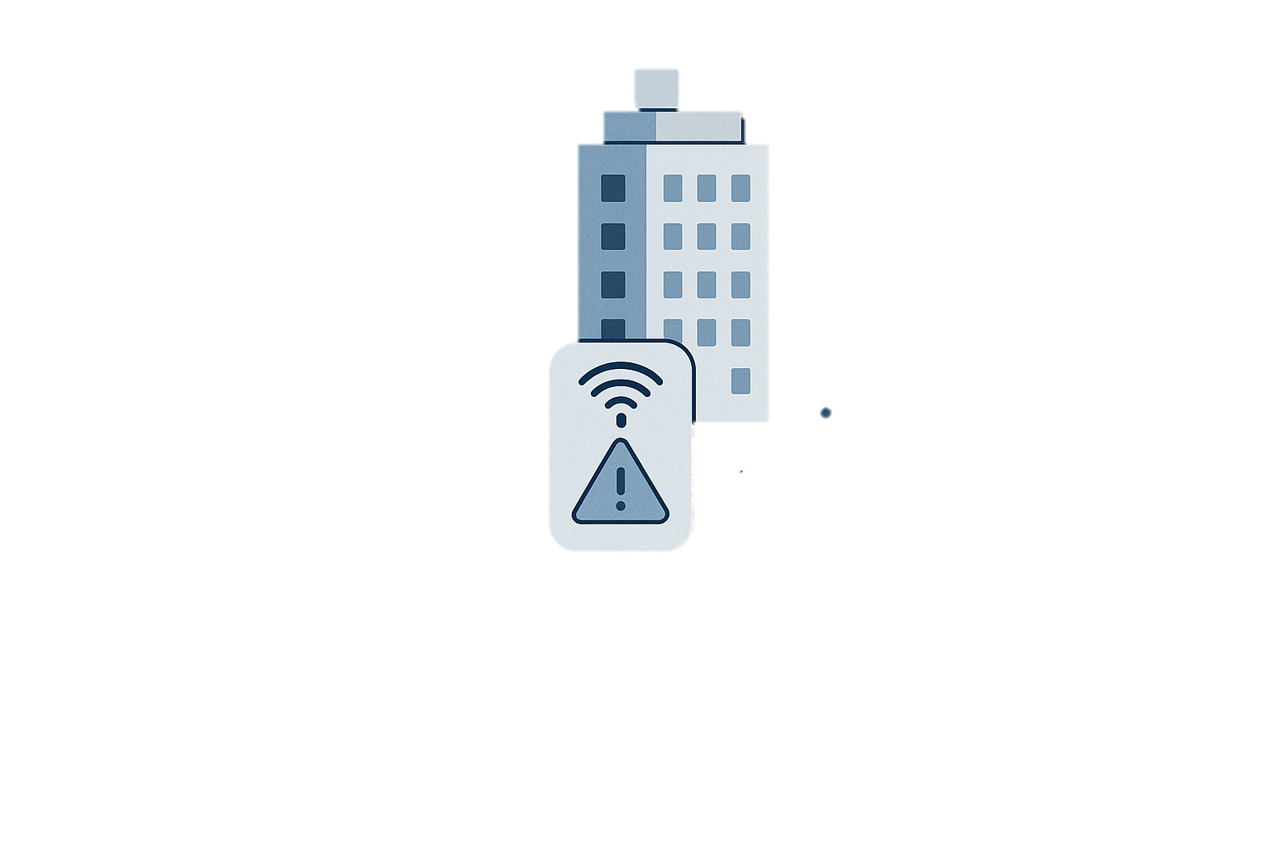

Singapore is leading southeast Asia’s shift to smart buildings enhancing efficiency, sustainability through advance FM software
Key Enablers
Challenges to overcome
Integration of Building management systems
Development of IoT sensors and predictive maintenance systems
Real-time space utilization and analytics
Adoption of open platform and standard
Skill gaps in FM workforce
High initial investment costs
Cybersecurity vulnerabilities
Outlook
Strategic solutions
Adoption of open platforms & standards
Enhanced cybersecurity protocols
Workforce upskilling initiatives
Government incentives to support adoption
Sustained government support
Industry-wide standardization
Continued training and cybersecurity focus

